Slide 1
Predicting Home Sale Prices in Ames, Iowa
Anchee, Emma, Shiona, Bella, and Nejma

Slide 2
Background Information, the Question
What attributes of a house affect its sale price?
We used data collected from home sales in Ames, Iowa from 2006 to 2010
79 variables in original data with 1,460 observations
Ames, Iowa is home to Iowa State University approximately 30 miles outside Des Moines
Between 2006 to 2010, the population ranged from 54,000 to 59,000
Notes:
Shiona’s Notes
The question we wanted to explore was what attributes of homes affect sale price
We used data on home sales in Ames, Iowa regarding their attributes and sale price
The original dataset consisted of of 79 attributes with 1,460 observations
Ames, Iowa is home to Iowa State University approximately 30 miles outside Des Moines.
The data was collected between 2006 to 2010 where the population ranged from 54,000 to 59,000

Slide 3
Methods
Selected variables of interest using economic knowledge
Data cleaning:
redefining levels of some factor variables
replacing null values from some variables
one-hot encoding for all factor variables
Training and validation sets for model building
Four different models tried for prediction:
Multiple linear regression (baseline)
Lasso multiple linear regression
Stochastic gradient-boosted decision trees
XGBoost decision tree with cross-validation
Metrics found for model accuracy
Root mean square error (RMSE)
Average prediction inaccuracy in dollars
Average prediction accuracy as a percent
Notes:
Nejma

Slide 4
Economic Background
Heterogeneity
Every house is unique
there aren’t ever full substitutes
Creates information asymmetry between buyers and sellers
Housing information is thus broken down into units of service(s)
Area Preference
Costs between neighborhoods can and will drastically vary depending on what's surrounding a given area/neighborhood
Ames, Iowa is a college Town (For Iowa State University)
Scarcity
Land is fixed and therefore so is Housing
2008 recession
Data was collected both before and after recession, which likely impacted sale prices
We talked to a home appraiser to see which variables to use from the data
Notes:
BELLA

Slide 5
Data Cleaning
Hand-selected variables of interest to include for analysis
MSZoning: The general zoning classification
LotArea: Lot size in square feet
LotConfig: Lot configuration
HouseStyle: Style of dwelling
OverallCond: Overall condition rating
YearBuilt: Original construction date
YearRemodAdd: Remodel date
BsmtCond: General condition of the basement
HeatingQC: Heating quality and condition
CentralAir: Central air conditioning
FullBath: Full bathrooms above grade
Bedroom: Number of bedrooms above basement level
Kitchen: Number of kitchens
GarageType: Garage location
GarageCars: Size of garage in car capacity
PavedDrive: Paved driveway
Fence: Fence quality
MoSold: Month Sold
YrSold: Year Sold
Notes:
Nejma

Slide 6
Data Cleaning
Redefine levels for some factor variables to simplify them
“Fence” was simplified to just “Fence” or “NoFence”
“Garage” was simplified to “Attached,” “Detached,” or “NoGarage”
“Basement” was simplified to “Basement” or “NoBasement”
“MoSold” was changed from numeric to character (“Jan” instead of 1)
Original training data was split into smaller training set and validation set
Random 75% for training, remaining 25% for testing
Variable encoding (next slide…)
Notes:
Shiona

Slide 7
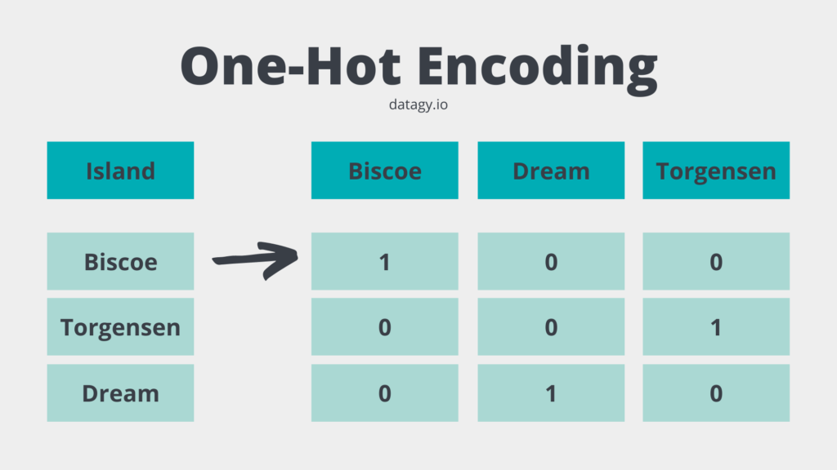
Variable Encoding
We used one-hot encoding
This encoding method turns factor and character variables into multiple columns, where each choice is its own column
Each new column is binary, with 0 for “no” and 1 for “yes”
This encoding method allows character data to be used in regression and treated as numeric data

Slide 8
Simple Multiple Linear Regression
Used as a baseline to compare results of other models against
Predicted SalePrice using every variable we selected except Id
We expected the results from this model to be less accurate
Results for this model:
RMSE of 50241.53
Adjusted R^2 of 0.6232 (62.32% of variability in data is explained by model)
F-statistic of 33.31
7 statistically significant variables (p-value < 0.05) out of 56 total variables used
Notes:
Anchee

Slide 9
Lasso Multiple Linear Regression
Lasso regression identifies which variables exhibit multicollinearity or have little to no influence on SalePrice
Produces a model where each variable is weighted more or less accordingly
We used this method over forward and backward elimination because it allowed us to more accurately isolate variables with the strongest association
Results for this model:
RMSE of 49252.32
21 variables were shrunk to a weight of zero out of 67 total variables
Notes:
Anchee

Slide 10
Stochastic Gradient Boosted Decision Tree
First model using ensemble learning, using gbm library
ran many tests using different tree depths and tree iterations to find the combination that reduced RMSE the most using repeated cross-validation
The best combination was then saved as its most successful model, which we used for prediction
We also made note of the best tree depth from this model and used it in the next model
Results for this model:
RMSE of 47484.04
Best tree depth of 7
Full results on next slide
Notes:
Emma

Slide 11
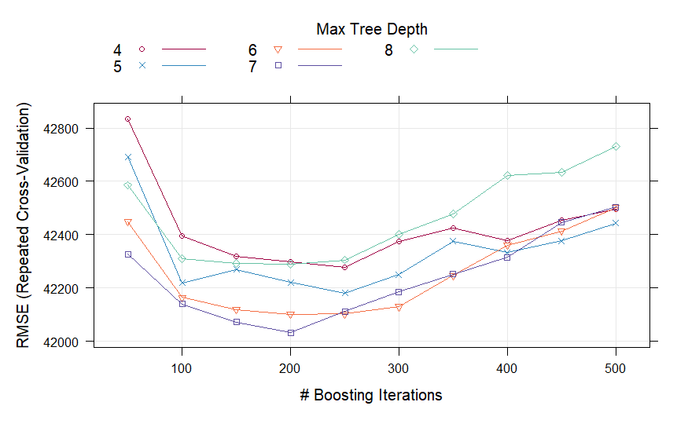
Notes:
Emma

Slide 12
XGBoost Gradient Boosted Decision Tree
Second model using ensemble learning, using xgboost library
Began by doing xgboost cross-validation to find the best number of iterations for a tree model with the best max depth found in the previous model
Result: best number of iterations was 474
Using this best number of iterations, we built an xgboost decision tree model
Along with SalePrice predictions, the model was used to produce a variable importance plot (next slide) using a metric called gain
Results for this model:
RMSE of 44005.16
Notes:
Emma

Slide 13
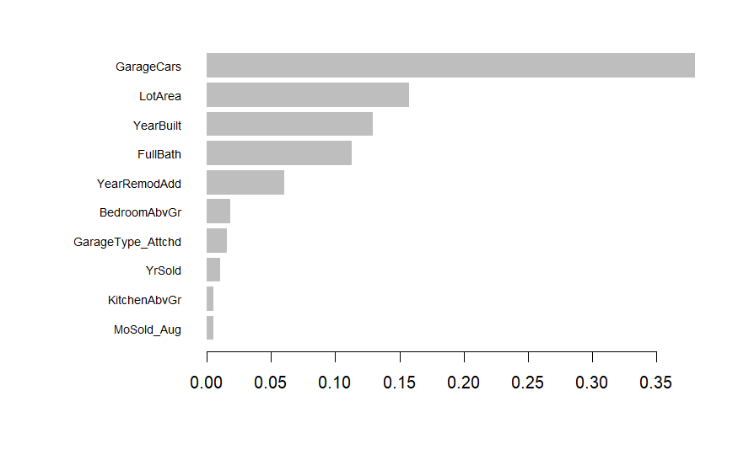
Notes:
Emma

Slide 14
Overall Results
 | RMSE | Average Pred Error | Average % Accuracy
Multiple Reg |  | $ | %
Lasso Reg |  | $ | %
Stochastic GB Tree |  | $ | %
XGBoost GB Tree |  | $ | %
Prediction Error = Absolute Value(Actual Sale Price - Price Prediction)
Tells us the dollar amount our prediction was off from the real sale price by
Percent Accuracy = 1 - (Prediction Error / Actual Sale Price)
Tells us how accurate our prediction of the sale price was as a percentage
Notes:
Shiona

Slide 15
Final Remarks, Future Research
Final Remarks:
Our best model was the XGBoost gradient-boosted decision tree
Lowest RMSE, lowest avg. prediction error, highest avg. percent accuracy
We will use the XGBoost model to make predictions on the test data
There is likely room for improvement in our research
Different variable selection methods
Split data to pre- and post- 2008 recession
Try principle component analysis
Future Research:
Would like to see how these attributes affect rent price(s)
Ames is college town, and therefore there’s going to be a population within the city that rents instead of buying a house
Updated data
Expanding location beyond Ames a little bit more
Updating the data so its more recent
Create variables for houses sold before 2008 recession and sold after 2008 recession
Notes:
Bella

Slide 16
Thank you!
Any questions?

